Slide 1
QC-MDPC (BIKE)
Failure Analysis Survey
Ray Perlner

Slide 2
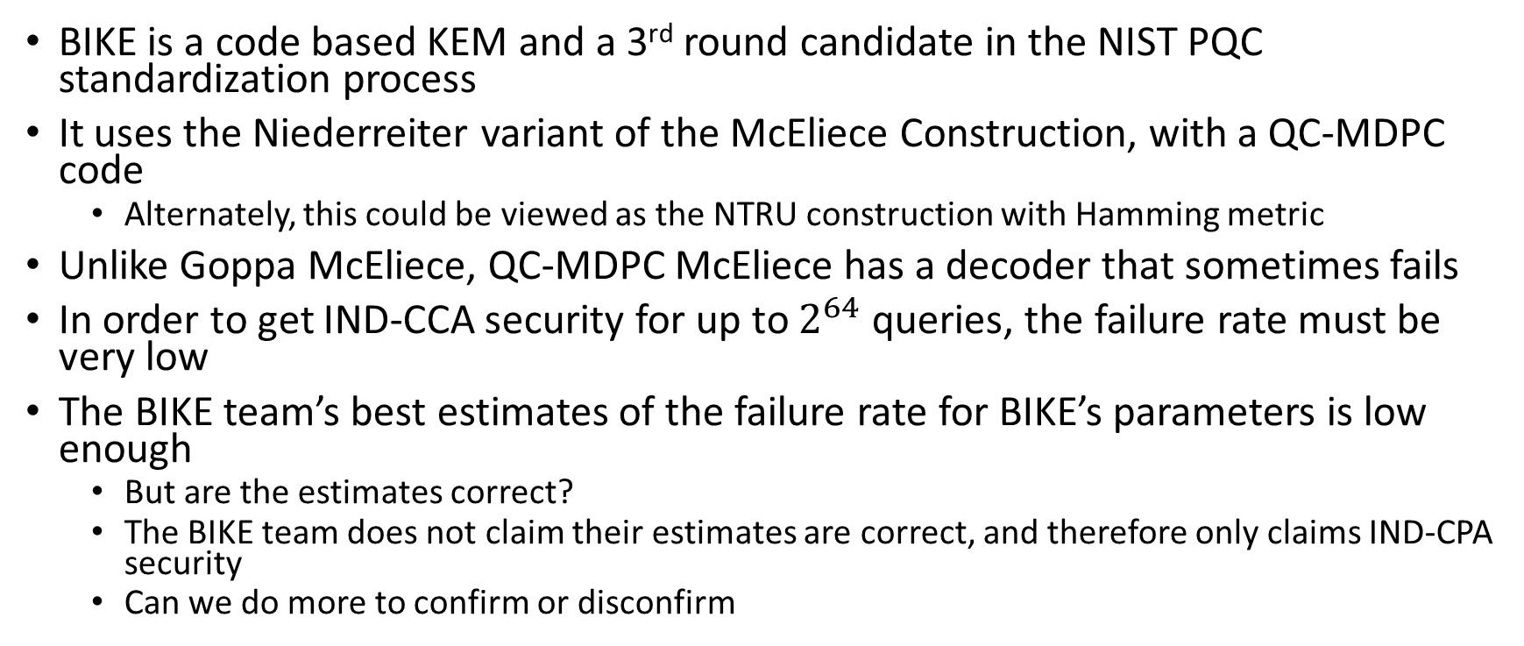
Overview
BIKE is a code based KEM and a 3rd round candidate in the NIST PQC standardization process
It uses the Niederreiter variant of the McEliece Construction, with a QC-MDPC code
  Alternately, this could be viewed as the NTRU construction with Hamming metric
Unlike Goppa McEliece, QC-MDPC McEliece has a decoder that sometimes fails
In order to get IND-CCA security for up to $2^{64}$ queries, the failure rate must be very low
The BIKE team’s best estimates of the failure rate for BIKE’s parameters is low enough
  But are the estimates correct?
  The BIKE team does not claim their estimates are correct, and therefore only claims IND-CPA security
  Can we do more to confirm or disconfirm

Slide 3
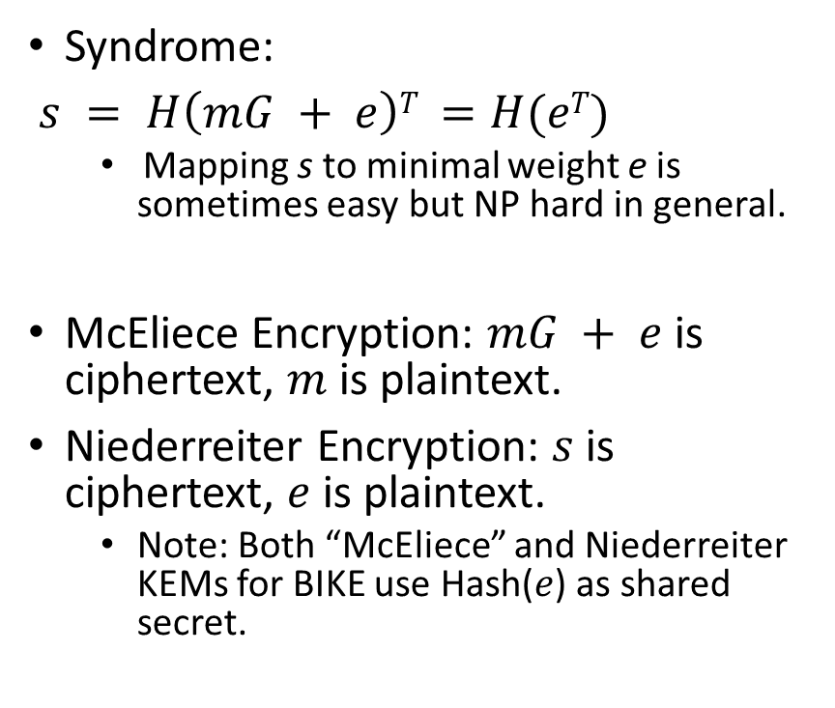
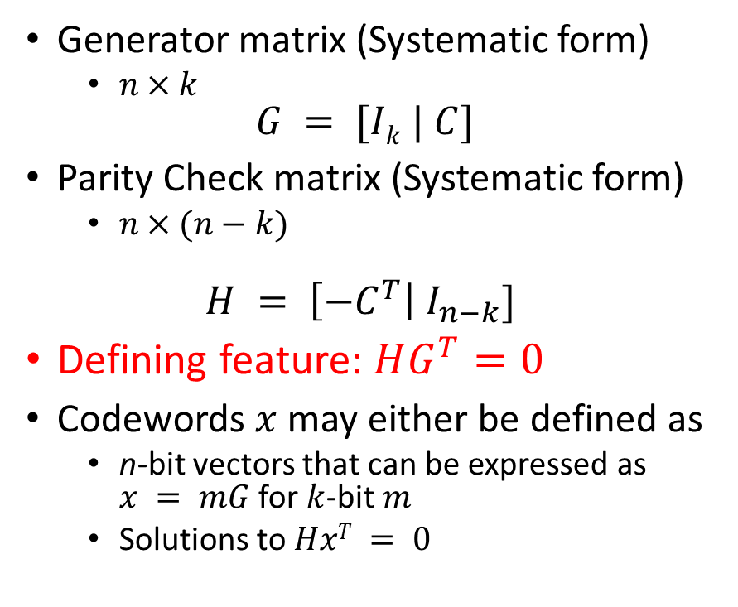
Some Coding Theory
Generator matrix (Systematic form)
  $n×k$
$$G = [Ik | C]$$
Parity Check matrix (Systematic form)
  $n×(n−k)$
$$H = \left[{−C}^{T}\right| I_{n−k}]$$
Defining feature: $HG^{T}=0$
Codewords $x$ may either be defined as
  n-bit vectors that can be expressed as $x = mG$ for $k$-bit $m$
  Solutions to $HxT = 0$
Syndrome:
$s = H\left(mG + e\right)T =H(eT)$
  Mapping s to minimal weight e is sometimes easy but NP hard in general.
McEliece Encryption: $mG + e$is ciphertext, $m$ is plaintext.
Niederreiter Encryption: $s$ is ciphertext, $e$ is plaintext.
  Note: Both “McEliece” and Niederreiter KEMs for BIKE use Hash($e$) as shared secret.

Slide 4
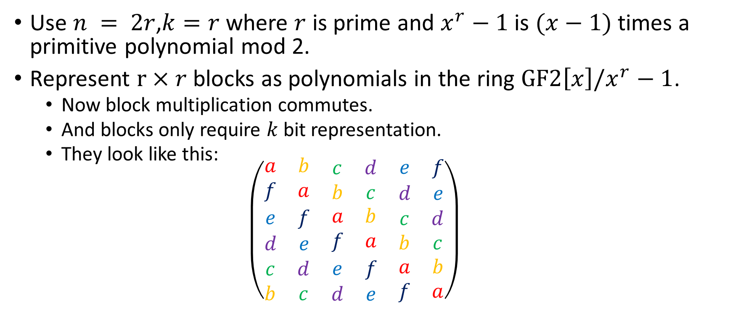
Quasi-Cyclic structure
Use $n = 2r$,$k=r$ where $r$ is prime and $x^{r}−1$ is $(x−1)$times a primitive polynomial mod 2.
Represent $r×r$ blocks as polynomials in the ring $GF2\left[x\right]/x^{r}−1$.
  Now block multiplication commutes.
  And blocks only require $k$ bit representation.
  They look like this:
  $$\left(\begin{matrix}\begin{matrix}a & b \\ f & a\end{matrix} & \begin{matrix}c & d \\ b & c\end{matrix} & \begin{matrix}e & f \\ d & e\end{matrix} \\ \begin{matrix}e & f \\ d & e\end{matrix} & \begin{matrix}a & b \\ f & a\end{matrix} & \begin{matrix}c & d \\ b & c\end{matrix} \\ \begin{matrix}c & d \\ b & c\end{matrix} & \begin{matrix}e & f \\ d & e\end{matrix} & \begin{matrix}a & b \\ f & a\end{matrix}\end{matrix}\right)$$

Slide 5
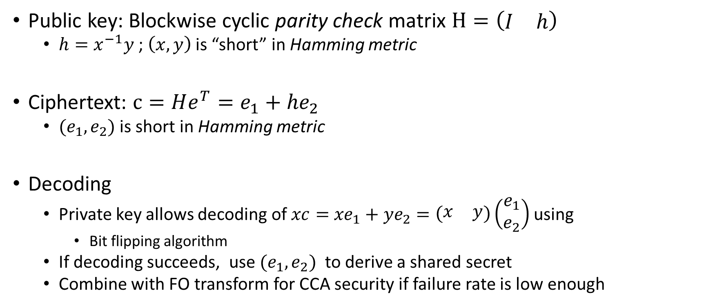
BIKE construction
(Niederreiter)
Public key: Blockwise cyclic parity check matrix $H=\left(\begin{matrix}I & h\end{matrix}\right)$
  $h=x^{−1}y$ ; $\left(x,y\right)$ is “short” in Hamming metric
Ciphertext: $c=He^{T}=e_{1}+{he}_{2}$
  $(e_{1},e_{2})$ is short in Hamming metric
Decoding
  Private key allows decoding of $xc=$ ${xe}_{1}+{ye}_{2}=\left(\begin{matrix}x & y\end{matrix}\right)\left(\begin{matrix}e_{1} \\ e_{2}\end{matrix}\right)$ using
    Bit flipping algorithm
  If decoding succeeds, use $(e_{1},e_{2})$ to derive a shared secret
  Combine with FO transform for CCA security if failure rate is low enough

Slide 6
BIKE parameters

Slide 7

Bit Flipping Decoder
We want to solve $\left(\begin{matrix}x & y\end{matrix}\right)\left(\begin{matrix}e_{1} \\ e_{2}\end{matrix}\right)=$ $\left(\begin{matrix}s_{1} \\ s_{2}\end{matrix}\right)$ for $\left(\begin{matrix}e_{1} \\ e_{2}\end{matrix}\right)$
  Think of $x, y$as matrices
Since

Slide 9
References
Reaction attack
  Guo, Johansson, Stankovski 2016: https://eprint.iacr.org/2016/858.pdf
Error Amplification
  Nilsson, Johansson, Wagner 2018: https://eprint.iacr.org/2018/1223.pdf
Estimating/bounding failure rate
  Markovian analysis (Simple decoder, infinite iterations)
    Sendrier, Vasseur 2018: https://eprint.iacr.org/2018/1207
  Extrapolation (Backflip decoder)
    Sendrier, Vasseur 2019: https://eprint.iacr.org/2019/1434.pdf
  Extrapolation (Black and Gray Decoder)
    Drucker, Gueron, Kostic 2019: https://eprint.iacr.org/2019/1423
  Explicit bounds for 1 (tight) or 2 (loose) iterations (IR BF Decoder)
    Baldi et al. 2020 https://re.public.polimi.it/retrieve/handle/11311/1144467/513367/SECRYPT_2020_118_CR.pdf
  Latest BIKE spec. https://bikesuite.org/files/v4.0/BIKE_Spec.2020.05.03.1.pdf

